Slide 1

DATABASES COURSE 2023/2024
SESSION 1

Slide 2
SESSION 1
DATABASE BASICS
CLIENT-SERVER ARCHITECTURE
TYPES OF DATABASES
SQL
CONFIGURE THE DATABASE

Slide 3
DATABASE BASICS
Database Definition
Is a set of data which is internally related.
Is usually managed by the DBMS (Data base Management System)
Regardless the size of the database, it allows the querying and retrieving data quickly and easily.
The BBDD is designed for an specific purpose.
It grows as the user requirements grows.

Slide 4
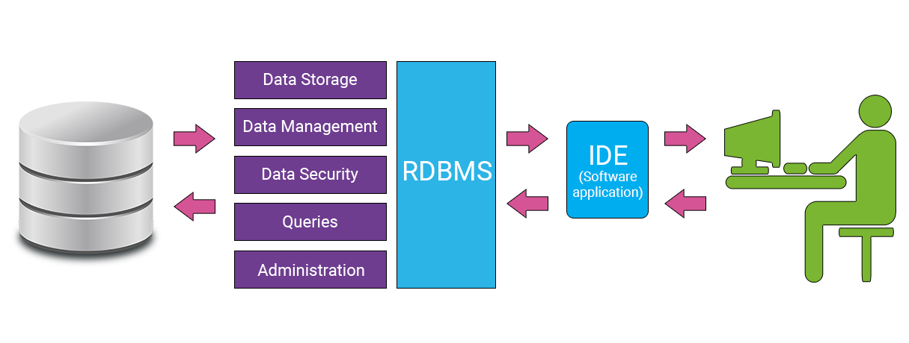
DATABASE BASICS
DBMS Definition
DBMS stands for Data Base Management System
Is the software which allows manipulate the database. It allows to add, remove and change data.
In general DBMS works implements the client-server architecture.

Slide 5

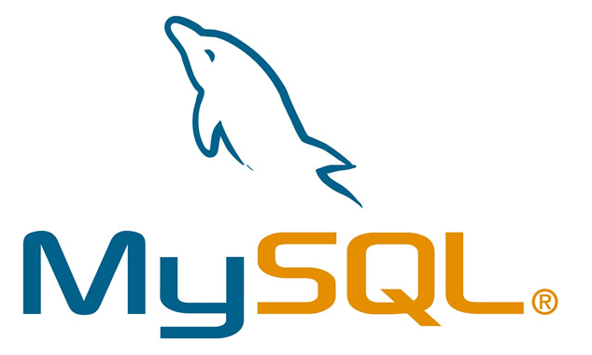

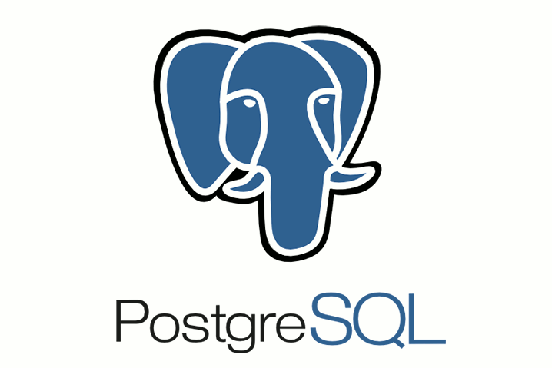
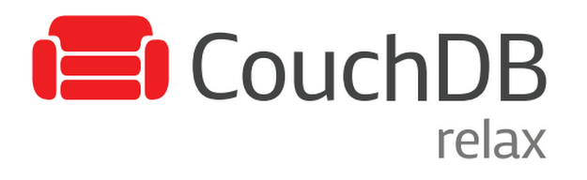


DATABASE BASICS
DBMS Examples

Slide 6


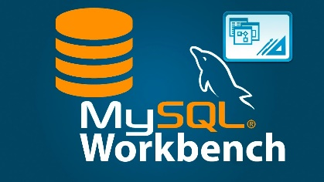
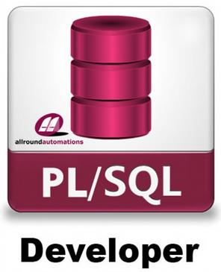

DATABASE BASICS
IDE Definition
IDE stands for Integrated Development environment.
Is the software used by the user to manage the DBMS.

Slide 7
SESSION 1
DATABASE BASICS
CLIENT-SERVER ARCHITECTURE
TYPES OF DATABASES
SQL
CONFIGURE THE DATABASE

Slide 8
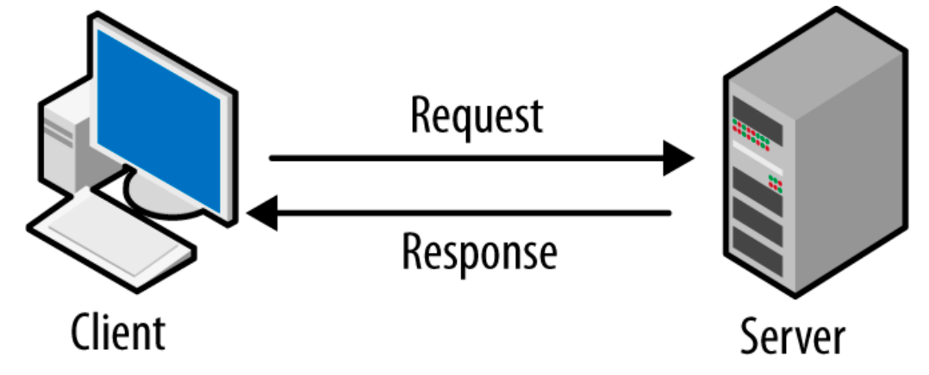
CLIENT-SERVER ARCHITECTURE
Definition
Almost all DBMS were designed to satisfy many users requests at the same time.
One user can request some information to the DBMS and this request have to be responded regardless the user ubication.
The user requests the information from the client side.
The DBMS responds to that request from the server side.

Slide 9

CLIENT-SERVER ARCHITECTURE
REMOTE Database
The server and the clients were installed in different computers. Most common use for Enterprise purposes

Slide 10
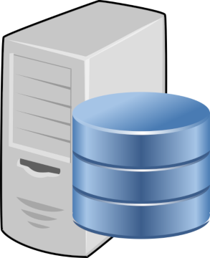
CLIENT-SERVER ARCHITECTURE
LOCAL Database
The server and the clients were installed in the same computers. Most common use for educational or experimental purposes.

Slide 11
SESSION 1
DATABASE BASICS
CLIENT-SERVER ARCHITECTURE
TYPES OF DATABASES
SQL
CONFIGURE THE DATABASE

Slide 12
TYPES OF DATABASES
Relational Database
NoSQL Database
Cloud Database
Object Oriented Database
Hierarchical Database
Network Database
Distributed Database
Notes:
https://www.javatpoint.com/types-of-databases

Slide 13
SESSION 1
DATABASE BASICS
CLIENT-SERVER ARCHITECTURE
TYPES OF DATABASES
SQL
CONFIGURE THE DATABASE

Slide 14
SQL
SQL stands for Structured Query Language.
The standard language for most relational databases.
No coding needed and high Speed.
Interactive Language. Easy to learn and understand.
SELECT Field1
FROM Table
WHERE Field1=Value1;

Slide 15
SQL
Year | Event
197x first years | Donald Chamberlin and Raymond Boyce worked in SEQUEL (Structured English Query Language) for IBM
 | SEQUEL was changed to SQL for trademark conflicts with a UK aircraft company
 | Larry Ellison (Larry) started to work in “Ampex”. This company had several contracts with US government
 | Larry lead a project related a Database systems for the CIA. Coded name "Oracle"
1977 | Larry leaves Ampex and creates "Software development Laboratories" ($2000)
1979 | "Software development Laboratories" is changed to "Relational Software INC". Chamberlin and Boyce work together for this company and release the first commercial version of the software: Oracle v2 (there was no v1)
1982 | "Relational Software INC" is changed to "Oracle Coporation"
1986 | Oracle goes into Stock Exchange
 | ANSI (American National Standards Institute). Announce the SQL as a International Standard
1990 | Oracle was about to bankrupt
1993 | Oracle released Oracle 7
1995 | Michael Wedinus (Monty) and David Axmark creates MySQLAB with the software MySQL
1998 | Evan Goldber (Oracle staff) leaves the company and creates Net Suite. Larry supports with 125 millions dollars

Slide 16
SQL
Year | Event
1999 | Mar Russel Beniof (Oracle staff) leaves the company and creates Salesforce. Larry supports him with 2 million dollars
 | Beniof realizes Larry was working closely with a Salesforce competitor. So Larry was fired from Salesforce direction.
 | Larry had some assets of Salesforce, so he has some benefits. (Currently estimated value of Salesforce is 207 K million dollars)
2003 | Oracle releases Oracle 10g
2004 | Oracle owns People Soft (10.3 K millions dollars)
2008 | Sun Microsystem owns MySQLAB (1 K millions dollars)
2009 | Monty leaves MySQLAB and creates "Monty Program AB" with the software "Maria DB"
2010 | Oracle owns Sun MicroSystem (7.4 K millions dollars)
2012 | “Maria DB Coporation” is created by Monty
2016 | Oracle owns Net Suite (9300 million dollars). Larry was 35% owner Oracle releases “Oracle Cloud”
2018 | Oracle releases "Oracle Autonomous Databases"
2021 | Oracle owns Cerner (28.3 K million dollars)
2022 | Oracle owns Verenia and AdilInsights
Notes:
SUN: Standford University Network

Slide 17
SESSION 1
DATABASE BASICS
CLIENT-SERVER ARCHITECTURE
TYPES OF DATABASES
SQL
CONFIGURE THE DATABASE

Slide 18
CONFIGURE THE DATABASE
BBDD/User: any/system
Oracle
As SYSTEM user:
Activate script execution
ALTER SESSION SET "_ORACLE_SCRIPT"=TRUE;
Create user for the schemas (data repositories):
CREATE USER myData IDENTIFIED BY password;
Grant some privileges to the user:
GRANT CREATE SESSION, ALTER SESSION, CREATE MATERIALIZED VIEW, CREATE PROCEDURE, CREATE ROLE, CREATE SEQUENCE, CREATE TABLE, CREATE TRIGGER, CREATE VIEW, UNLIMITED TABLESPACE to myData;
Finally, disconnect from SYSTEM user and connect with the previously created users, or simply execute this:
ALTER SESSION SET CURRENT_SCHEMA=myData;
MySQL
As ROOT user:
Create the databases to use:
CREATE DATABASE myData
Change to the database previously create:
USE myData
Notes:
In MySQL, schema is synonymous with database
CREATE SCHEMA is a synonym for CREATE DATABASE. (https://dev.mysql.com/doc/refman/8.0/en/create-database.html#:~:text=CREATE%20DATABASE%20creates%20a%20database,not%20specify%20IF%20NOT%20EXISTS%20.)

